Slide 1

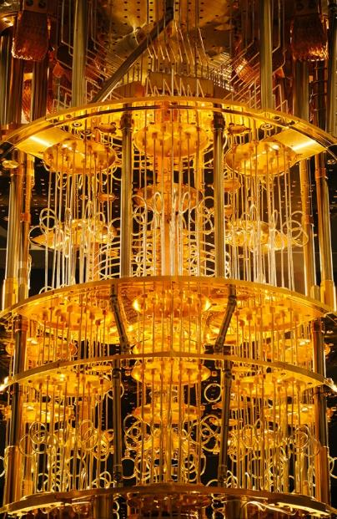
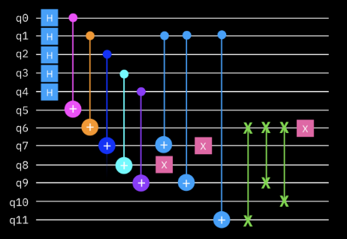



Foundations of
Quantum Information Science (QIS 102)
Dave Biersach
Brookhaven National Laboratory
dbiersach@bnl.gov
Session 22
Quantum Algorithms

Slide 2
Session 22 – Part 1 of 2 – Topics
Review the Kronecker product of vectors and how to boost the tensor rank of a vector to be that of a matrix
How to manipulate a qubit's phase using quantum gates
Analyze the phenomenon of phase kickback between entangled qubits
Implement the Deutsch Oracle using Qiskit and mathematically trace the Deutsch algorithm
Implement the Deutsch-Jozsa Oracle using matrices
Understand how Grover's Algorithm leverages phase amplification to increase the probability that a wave function will collapse to a meaningful state

Slide 3
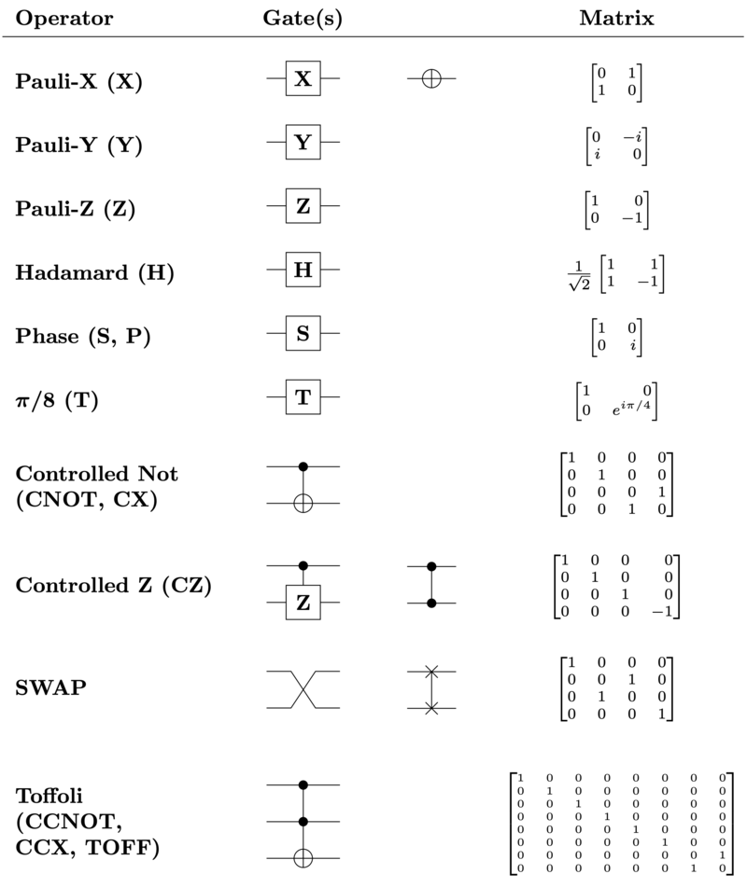

Slide 4
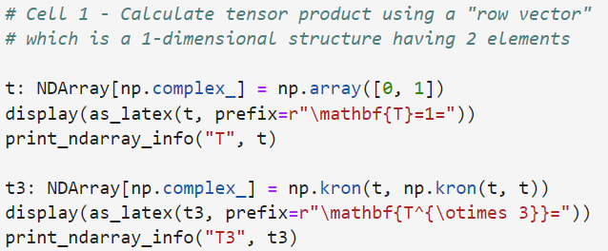
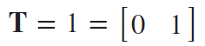
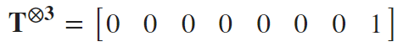
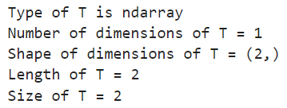
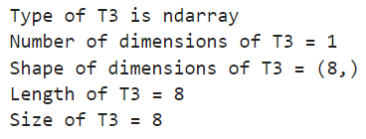
Run Cell 1 – phase_kickback.ipynb
①
②
③
④
⑤

Slide 5
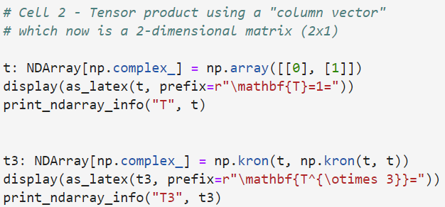
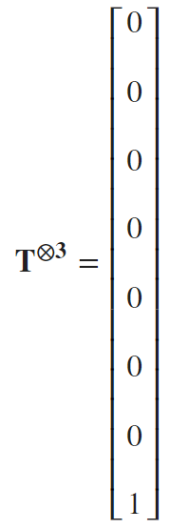
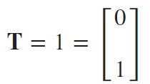
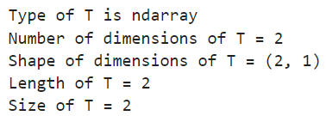
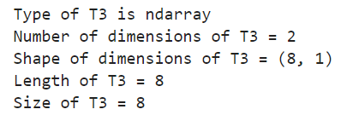
Run Cell 2 phase_kickback.ipynb
①
②
③
④
⑤

Slide 6
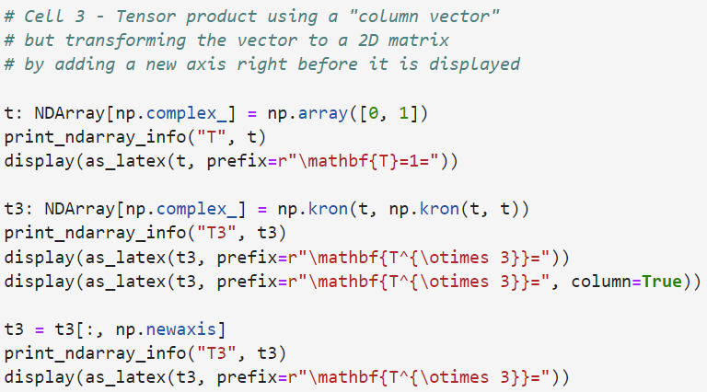
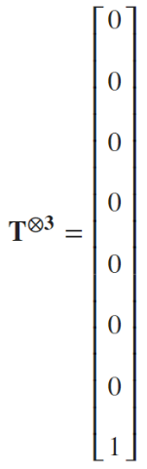
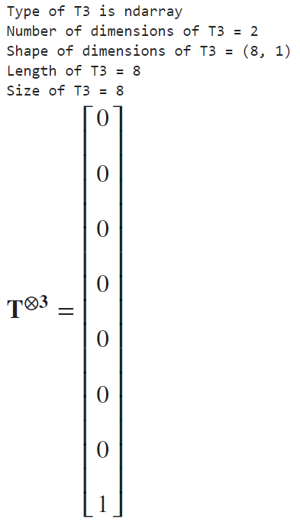
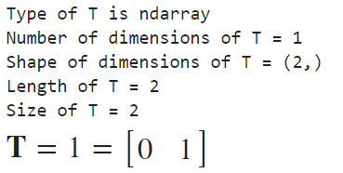
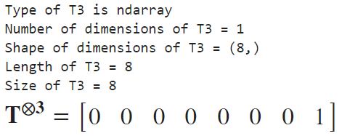
Run Cell 3 – phase_kickback.ipynb
①
②
③
⑤
These
"look"
similar
⑥
④

Slide 7
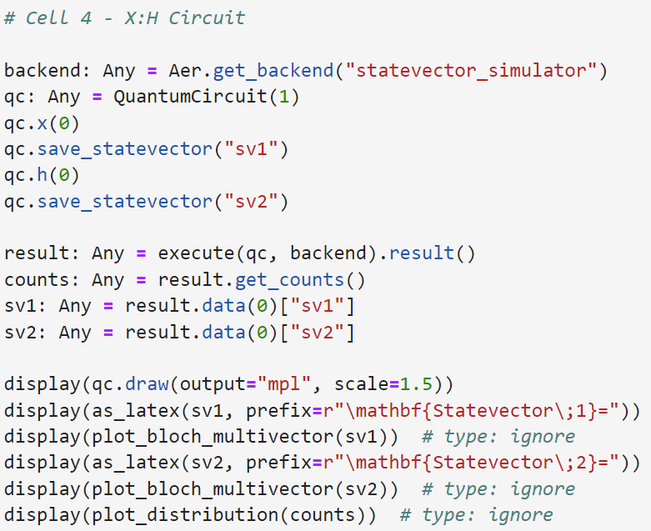
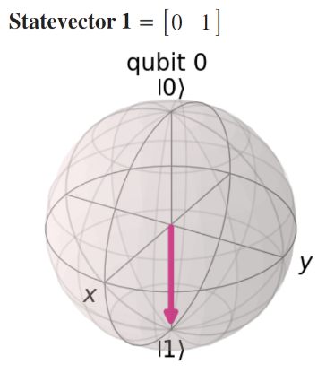
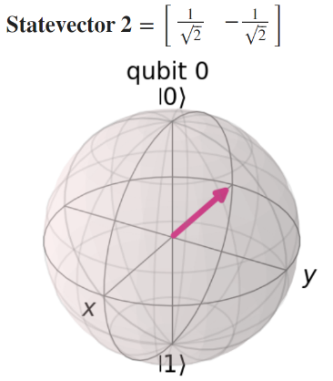
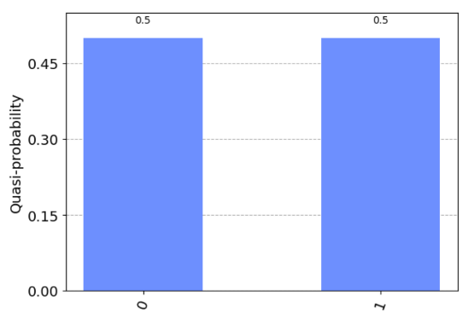
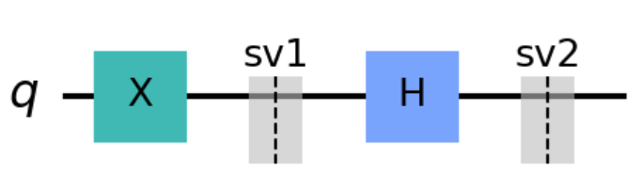

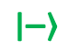
Run Cell 4 phase_kickback.ipynb
①
②
③
④
⑤
$$\left|\left.−\right\rangle \right.$$
⑥
$$\left|\left.+\right\rangle \right.$$

Slide 8
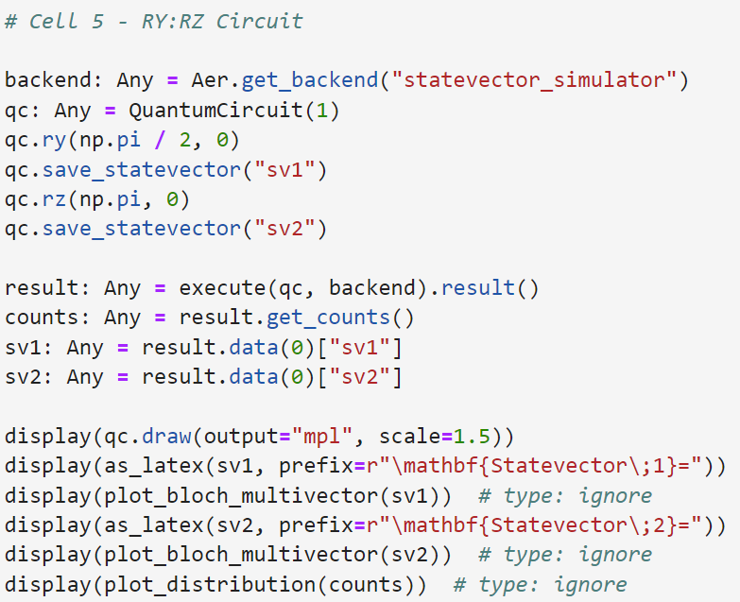
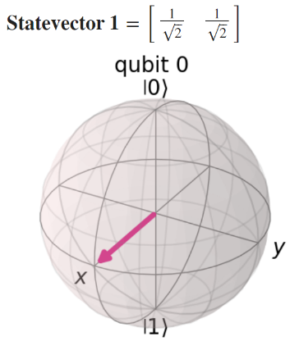
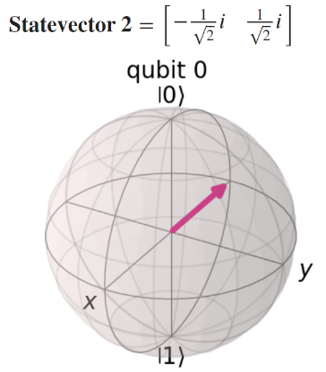
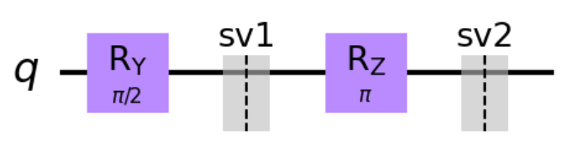
Run Cell 5 phase_kickback.ipynb
①
②
③
④
⑤
⑥

Slide 9
The Route Matters
The probabilities are the same, but the amplitudes are not!

Slide 10
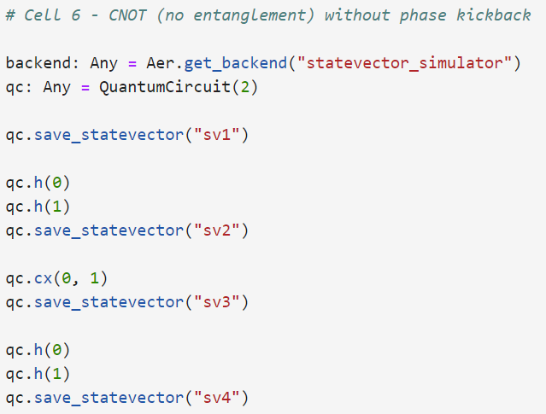
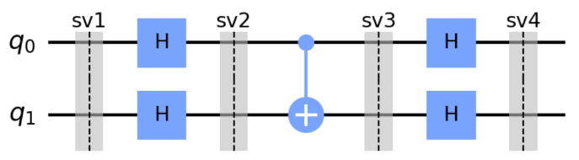
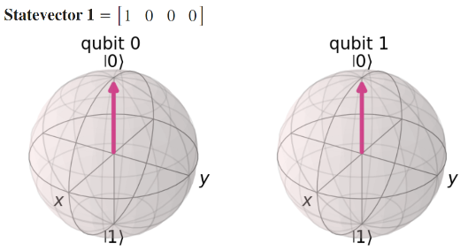
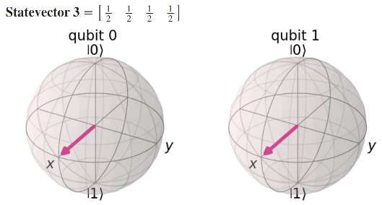
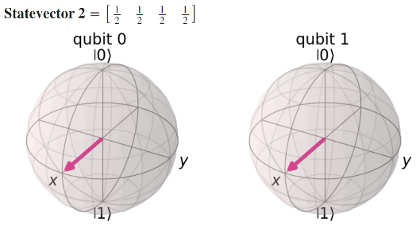
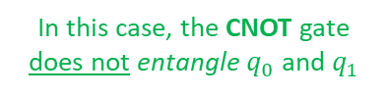
①
Run Cell 6 phase_kickback.ipynb
②
③
④
⑤
In this case, the CNOT gate
does not entangle $q_{0}$ and $q_{1}$
1
0

Slide 11

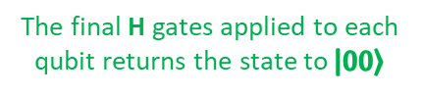
①
Run Cell 6 phase_kickback.ipynb
②
③
④
⑤
The final H gates applied to each qubit returns the state to $\left|\left.00\right\rangle \right.$

Slide 12
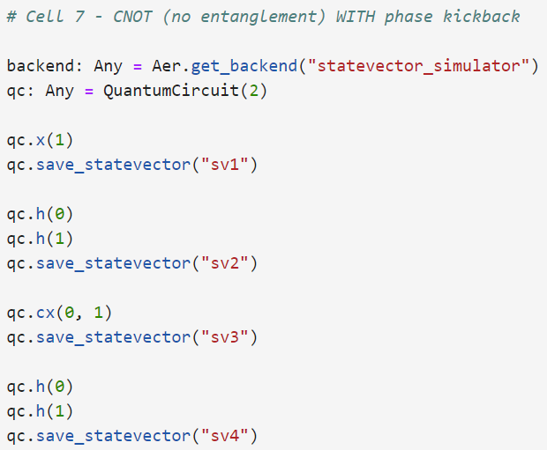
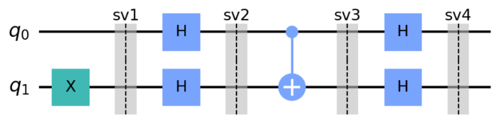
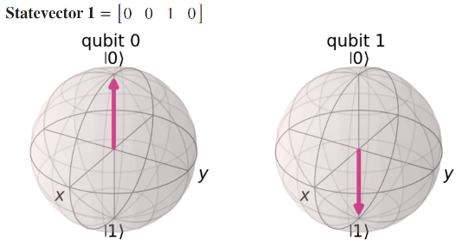
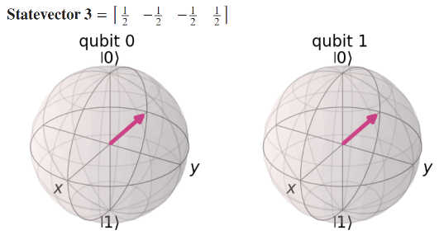
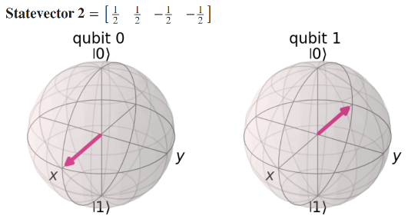
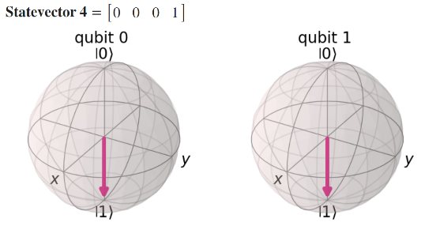
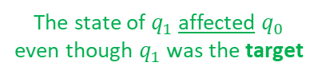
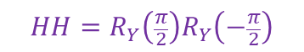
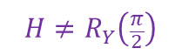
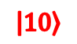
①
Run Cell 7 phase_kickback.ipynb
②
③
$$\left|\left.10\right\rangle \right.$$
④
⑤
The negative phase moved backwards
The state of $q_{1}$ affected $q_{0}$ even though $q_{1}$ was the target
⑥
$$H≠R_{Y}\left(\frac{π}{2}\right)$$
$$HH=R_{Y}\left(\frac{π}{2}\right)R_{Y}\left(−\frac{π}{2}\right)$$

Slide 13
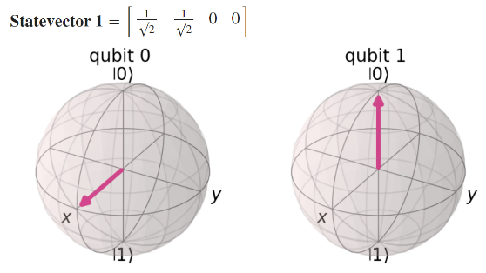
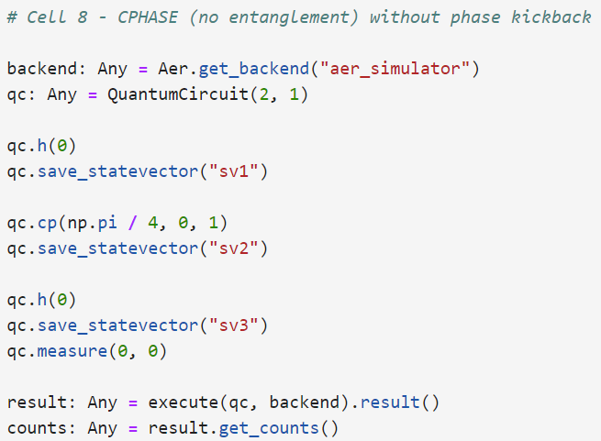

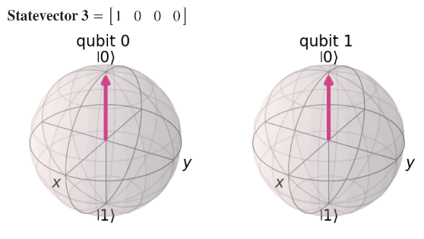
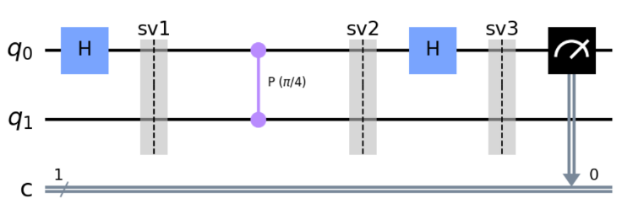
Run Cell 8 phase_kickback.ipynb
①
②
③
④
⑤
Unlike CNOT, CCNOT, or CSWAP, a CPHASE applies a phase shift symmetrically (to both target and control lines) but only when both qubits are in the |1> state. Therefore, there is no need to differentiate the control and target qubits, and that is why CPHASE is a straight line connecting two qubits with an angle indicator.

Slide 14
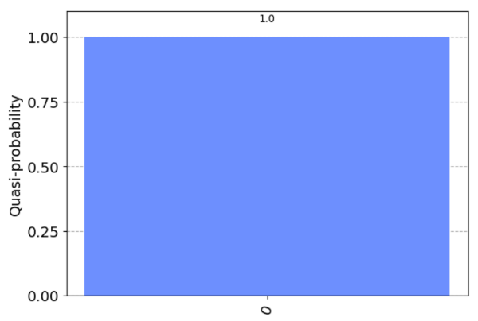

Run Cell 8 phase_kickback.ipynb
The CPhase$\left(π/4\right)$ gate has no effect on $q_{0}$ if $q_{1}$ is in the $\left|\left.0\right\rangle \right.$ state
①
②
③
④
⑤
⑥

Slide 15





Run Cell 9 phase_kickback.ipynb
①
②
③
④
⑤

Slide 16


Run Cell 9 phase_kickback.ipynb
Because $q_{1}$started in the $\left|\left.1\right\rangle \right.$ state,
the CPhase$\left(π/4\right)$ gate has affected $q_{0}$ due to kickback
①
②
It no longer measures only 0 as on slide 14
③
④
⑤
⑥

Slide 17






Run Cell 10 phase_kickback.ipynb
①
Supposed we didn't know this phase $φ$
②
③
④
⑤

Slide 18


Run Cell 10 phase_kickback.ipynb
Because all measurements of $q_{0}$ are $\left|\left.0\right\rangle \right.$ we know the initial phase of $q_{0}$ must equal the CPhase$\left(π/4\right)$ gate angle
①
②
③
④
⑤
⑥

Slide 19





Run Cell 11 phase_kickback.ipynb
①
②
③
④
⑤

Slide 20


Run Cell 11 phase_kickback.ipynb
Because we got at least one $\left|\left.1\right\rangle \right.$ measurement, we know the initial phase of $q_{0}$ was not equal to the CPhase$\left(π/4\right)$ gate angle
①
②
③
④
⑤
⑥

Slide 21




The Deutsch Algorithm
You are the traveler
You are the traveler, and you prepare two qubits $q_{0}$ and $q_{1}$ in whatever state you wish
You approach me, the Oracle, and present your two qubits
I apply one of four possible secret functions to your two qubits and return the two qubits to you
I am the wise Oracle
You are free to do what you want with the qubits afterward, but at some point, you must measure one (and only one) of the qubits $q_{0}$ or $q_{1}$
Based upon your single measurement, you must tell me which type of function I applied

Slide 22




The Deutsch Algorithm
You are the traveler
There are four possible secret functions and only the Oracle knows which one is used
Type of Function
NOP – I don't change your $q_{0}$qubit at all (no operation) e.g., $\left.\left|0\right.\right\rangle →\left.\left|0\right.\right\rangle ,\left.\left|1\right.\right\rangle →\left.\left|1\right.\right\rangle$
Balanced
Always 0 – I always set your qubit $q_{0}$ to the $\left.\left|0\right.\right\rangle$ state
Constant
I am the wise Oracle
Always 1 – I always set your qubit $q_{0}$ to the $\left.\left|1\right.\right\rangle$ state
Constant
NOT – I invert your $q_{0}$ qubit with an X gate e.g., $\left.\left|0\right.\right\rangle →\left.\left|1\right.\right\rangle ,\left.\left|1\right.\right\rangle →\left.\left|0\right.\right\rangle$
Balanced

Slide 23
The Deutsch Algorithm
You are the traveler
How many trips to the Oracle must you make
to know for sure if my secret function
is Balanced or Constant ?
Type of Function
NOP – I don't change your $q_{0}$qubit at all (no operation) e.g., $\left.\left|0\right.\right\rangle →\left.\left|0\right.\right\rangle ,\left.\left|1\right.\right\rangle →\left.\left|1\right.\right\rangle$
Balanced
Always 0 – I always set your qubit $q_{0}$ to the $\left.\left|0\right.\right\rangle$ state
Constant
I am the wise Oracle
Always 1 – I always set your qubit $q_{0}$ to the $\left.\left|1\right.\right\rangle$ state
Constant
NOT – I invert your $q_{0}$ qubit with an X gate e.g., $\left.\left|0\right.\right\rangle →\left.\left|1\right.\right\rangle ,\left.\left|1\right.\right\rangle →\left.\left|0\right.\right\rangle$
Balanced

Slide 24





Deutsch-Jozsa Algorithm

Slide 25
Quantum Supremacy
The Deutsch-Jozsa algorithm demonstrates (but does not prove) quantum supremacy because no classical computer can outperform this specific quantum circuit
Deutsch's 1985 paper described an Oracle with a single input, but in 1992, he (along with Richard Jozsa) expanded the algorithm to include any number of inputs
With four possible secret functions: no operation (NOP), constant 0, constant 1, and inverse (NOT), one might assume two trips to the Oracle would be required to prove beyond any doubt which type of secret function was applied
But Deutsch changes the basis so we can answer the question "constant or balanced?" with just one trip to the Oracle

Slide 26








The Deutsch Algorithm
The Oracle's secret function sits between sv2 and sv3
There are four possible secret functions - only the Oracle knows which one is being used
Type of Function
NOP – I don't change your $q_{0}$qubit at all (no operation) e.g., $\left.\left|0\right.\right\rangle →\left.\left|0\right.\right\rangle ,\left.\left|1\right.\right\rangle →\left.\left|1\right.\right\rangle$
Balanced
Always 0 – I always set your qubit $q_{0}$ to the $\left.\left|0\right.\right\rangle$ state
Constant
Always 1 – I always set your qubit $q_{0}$ to the $\left.\left|1\right.\right\rangle$ state
Constant
NOT – I invert your $q_{0}$ qubit with an X gate e.g., $\left.\left|0\right.\right\rangle →\left.\left|1\right.\right\rangle ,\left.\left|1\right.\right\rangle →\left.\left|0\right.\right\rangle$
Balanced

Slide 27




Run Cells 1 to 8 – deutsch.ipynb
There are four possible secret functions - only the Oracle knows which one is being used
Type of Function
Cell 1 – NOP : $q_{0}$ $\left.\left|0\right.\right\rangle →\left.\left|0\right.\right\rangle$
Cell 2 – NOP : $q_{0}$ $\left.\left|1\right.\right\rangle →\left.\left|1\right.\right\rangle$
Balanced
Cell 3 – Always 0 : $q_{0}$ $\left.\left|0\right.\right\rangle →\left.\left|0\right.\right\rangle$
Cell 4 – Always 0 : $q_{0}$ $\left.\left|1\right.\right\rangle →\left.\left|0\right.\right\rangle$
Constant
Cell 5 – Always 1 : $q_{0}$ $\left.\left|0\right.\right\rangle →\left.\left|1\right.\right\rangle$
Cell 6 – Always 1 : $q_{0}$ $\left.\left|1\right.\right\rangle →\left.\left|0\right.\right\rangle$
Constant
Cell 7 – NOT : $q_{0}$ $\left.\left|0\right.\right\rangle →\left.\left|1\right.\right\rangle$
Cell 8 – NOT : $q_{0}$ $\left.\left|1\right.\right\rangle →\left.\left|0\right.\right\rangle$
Balanced

Slide 28


The Deutsch Algorithm
You are the traveler
How many trips to the Oracle must you make
to know for sure if the secret function
is Balanced or Constant ?
You are the traveler, and you prepare two qubits $q_{0}$ and $q_{1}$ in whatever state you wish
You are free to do what you want with the qubits afterward, but at some point, you must measure one (and only one) of the qubits $q_{0}$ or $q_{1}$
I am the wise Oracle
The secret function we don't know

Slide 29



The Deutsch Algorithm
You are the traveler
How many trips to the Oracle must you make
to know for sure if the secret function
is Balanced or Constant ?
ONE !
Invert $q_{1}$ then put both qubits into a superposition, and then send them into the Oracle's secret function
After the secret function, take $q_{0}$ out of superposition and measure its value to determine if the Oracle was balanced or constant
I am the wise Oracle
The secret function we don't know

Slide 30






Run Cell 9 – deutsch.ipynb
①
②
00
10
③
NOP

Slide 31





Run Cell 10 – deutsch.ipynb
①
②
01
11
③
Always 0

Slide 32



Run Cell 11 – deutsch.ipynb
①
②
01
11
③
Always 1

Slide 33



Run Cell 12 – deutsch.ipynb
①
②
00
10
③
NOT

Slide 34



Deutsch's Algorithm – The Math
Think FOIL, regroup, then factor out
$\left|\left.0\right\rangle \right.$ and $\left|\left.1\right\rangle \right.$

Slide 35


Deutsch's Algorithm – The Math

Slide 36

Deutsch's Algorithm – The Math

Slide 37







The Deutsch-Jozsa Oracle
Inputs:
x is a two-qubit register (tensor)
y is an independent qubit
Consider the following
balanced function
The Secret Function
$$x$$
$$f(x)$$
$$x$$
$$y$$
$$x$$
$$y^{′}$$
We don't "know" this matrix as it is the nature (type) of $f\left(x\right)$ that we are trying to discover!
$$y^{′}=f(x)⊕y$$

Slide 38




A Quantum Algorithm as a Matrix
x
g1
y
I
g2
g3
t1
t2
g4
Assume n = 2 as our secret function maps two input bits to a single bit
Only a constant function will produce a $\left.|ψ\right\rangle$ of $\left[x,0,0,0,0,0,0,0\right]$

Slide 39


Open Cell 1 deutsch_jozsa.ipynb
①
②
③
Note: This notebook does not use any Qiskit features. It uses only pure linear (matrix) algebra
⑥
⑦
⑧
⑨
⑩
④
⑤

Slide 40


Run Cells 1-4 deutsch_Jozsa.ipynb
①
②
③
④

Slide 41

The Deutsch-Jozsa Oracle
On a quantum computer, we can answer the question of whether the hidden function is balanced or constant in just one step – no matter the number of input qubits!
This is exponential speed-up over the provably optimal classical algorithm which requires (on average) $2^{n−1}+1$ steps for a function with $n$ inputs
This is an admittedly contrived problem, but it shows the potential for a quantum computer to outperform classical algorithms that were thought to be "optimal"
It is also noteworthy that to learn the fundamentals of quantum computing, you only need to know a little Python and appreciate complex numbers and matrix algebra

Slide 42

The Deutsch-Jozsa Oracle
IBM Qiskit Textbook (Retired): Deutsch-Jozsa Algorithm

Slide 43







Grover's Algorithm
Finding the Winner
Avg. Case = N / 2
Worst Case = N
N slots
if N = 3
(number of slots)
map to
This matrix puts the winner in slot 5
(zero-indexed)
$ω$ is the slot with the winner
= $5_{10}$

Slide 44

Grover's Algorithm
Ancilla qubit

Slide 45




Grover's Algorithm
Assume four slots (N = 2)
Initialization
$$U_{f}$$
$$\left|\left.s\right\rangle \right.$$
To find the winner among 4 slots we only need to run Grover's algorithm once
The Oracle decrees (encodes) which state is the winner
A CZ gate marks the winner to be in slot 3 aka [0,0,0,1]
The current mean amplitude

Slide 46

Grover's Algorithm
Initialization
$$U_{f}$$
$$\left|\left.s\right\rangle \right.$$
The Oracle decrees (encodes) which state is the winner
A CZ gate marks the winner to be in slot 3 aka [0,0,0,1]
Recall that the Oracle marks only the winning slot with a negative phase
The new mean amplitude

Slide 47

Grover's Algorithm
Initialization
$$U_{f}$$
$$\left|\left.s\right\rangle \right.$$
The Oracle decrees (encodes) which state is the winner
A CZ gate marks the winner to be in slot 3 aka [0,0,0,1]
We have amplified the amplitude of the winning state!
The new mean amplitude

Slide 48

Grover's Algorithm
Yes, we would need to know the location of the winning slot ahead of time to construct the Oracle's unitary matrix so we cannot magically use Grover's algorithm on existing classical (non-quantum) databases.
But the algorithm shows that we can (on average) “search” an unordered list on a quantum computer faster than on a classical computer

Slide 49

Run Cell 1 – grover.ipynb
①
②

Slide 50




Run Cell 2 - grover.ipynb
①
②
③
The winner is in slot 3 [0,0,0,1]
⑤
④
⑥
⑦
⑧
⑨
⑩
sv1
sv2
sv3
sv4
sv5
sv6

Slide 51




①
Run Cells 3 & 4 grover.ipynb
②
③
sv1
sv2
④
⑤
⑥
sv1
sv2
⑦
⑧
⑩

Slide 52






①
Run Cells 5 & 6 grover.ipynb
②
sv1
sv2
③
sv1
sv2
④
⑤
⑥
⑦
⑧
$$\left|\left.00\right\rangle \right.$$

Slide 53
Session 22 – Part 2 of 2 - Topics
Appreciate how qubits enable superdense coding
Obtain an IBM Cloud Account (IBMid) and a Qiskit API Key
Understand the QiskitRunTimeService and the Qiskit Sampler & Estimator primitives
Create a Bell Pair on a real IBM Quantum Computer
Apply principles of the Fourier Transform to perform Quantum Phase Estimation (QPE) on a qubit
Implement a simple Variation Quantum Eigensolver (VQE) to find the minimum eigenvalue of a Hamiltonian Operator
Consider if superposition and entanglement enable a sub-exponential solution to the Boolean Satisfiability Problem

Slide 54
Super Dense Coding
Superdense coding is a quantum communication protocol that allows transmitting two classical bits using only a single qubit as the carrier. Consequently, superdense coding doubles the efficiency of classical information transmission compared to traditional methods where one qubit carries only one classical bit
Superdense coding can be combined with other quantum protocols, such as quantum key distribution (QKD), to improve security in communication channels. QKD enables the secure distribution of cryptographic keys based on the laws of quantum mechanics. By utilizing superdense coding, these keys can be transmitted more efficiently and securely, reducing the vulnerability to eavesdropping or interception
Superdense coding offers benefits such as increased information transmission efficiency, resource conservation, compatibility with quantum networks, enhanced security, and contributions to the progress of quantum information science. These advantages make superdense coding a valuable tool in the field of quantum communication and quantum computing

Slide 55





Superdense Coding
Two classical bits
A trusted third party entangles two qubits
Qubit A
Charles Bennett
(1943 - )
Qubit B

Slide 56


View Cell 1 superdense_coding.ipynb
①
②
③
ba
④
⑤
Z must be applied before X
⑥
⑦
⑩
⑧
⑨

Slide 57



Run Cell 1 – superdense_coding.ipynb

Slide 58



Check Cell 1 – superdense_coding.ipynb

Slide 59



Check Cell 1 – superdense_coding.ipynb

Slide 60



Check Cell 1 – superdense_coding.ipynb
Sometimes, recognizing that negative phases are meaningless once measured, gives us a little more wiggle room when designing an encoding strategy…

Slide 61



IBM Quantum Computers
Yorktown Heights, NY

Slide 62

Create an IBM Account
https://www.ibm.com/account/reg/us-en/signup?formid=urx-19776

Slide 63

Create an API Token
https://quantum-computing.ibm.com/account
Your API token contains 128 random alphanumeric characters (ASCII)

Slide 64

IBM Qiskit Runtime
https://quantum-computing.ibm.com/admin/docs/admin/runtime

Slide 65


IBM Qiskit Runtime – Available Computers
https://quantum-computing.ibm.com/services/resources?tab=systems

Slide 66

IBM Qiskit Runtime – Available Computers
https://quantum-computing.ibm.com/services/resources?tab=systems

Slide 67

IBM Qiskit Runtime – Available Computers

Slide 68

Edit Cell 1 – qiskit_runtime.ipynb
Paste your API key here
①
②
③
④
⑤

Slide 69

Run Cell 1 – qiskit_runtime.ipynb
$HOME/.qiskit/qiskit-ibm.json
①
Your API key

Slide 70

Run Cell 2 – qiskit_runtime.ipynb
①
②
③

Slide 71


Run Cell 3 – qiskit_runtime.ipynb
$${\left.\left|Φ^{+}\right.\right\rangle }_{AB}=\frac{1}{\sqrt{2}}\left({\left.\left|0\right.\right\rangle }_{A}⨂{\left.\left|0\right.\right\rangle }_{b}+{\left.\left|1\right.\right\rangle }_{A}⨂{\left.\left|1\right.\right\rangle }_{b}\right)$$
https://en.wikipedia.org/wiki/Bell_state

Slide 72

Run Cell 4 – qiskit_runtime.ipynb
①
ISA = Instruction Set Architecture

Slide 73


Run Cell 5 – qiskit_runtime.ipynb
①
②
③
④

Slide 74

IBM Qiskit Runtime – Your Jobs
https://quantum-computing.ibm.com/jobs

Slide 75

Run Cell 5 (Alternate)
①
FakeAlmadenV2 simulates the characteristics of the actual IBM Quantum Almaden V2 device. This includes qubit connectivity, gate errors, and decoherence times
It allows users to develop and test quantum circuits as if they were running on the actual Almaden V2 device without requiring access to the real hardware
The mock backend can be used with Qiskit's transpiler and scheduler, making it possible to develop and optimize circuits with realistic constraints

Slide 76
Run Cell 5 (Alternate)
①
②
③

Slide 77



Run Cell 6 – qiskit_runtime.ipynb
PUB = Primitive Unified Bloc
①
②
③
evs = Expectation Values
John Stewart Bell
④
(1928 – 1990)
Entangled Qubits
https://en.wikipedia.org/wiki/Noisy_intermediate-scale_quantum_era
NISQ

Slide 78


IBM Paid Plans for Priority Runs
https://quantum-computing.ibm.com/jobs
Wait time before run: 1 hour
Time to run circuit: 18 seconds
https://www.ibm.com/quantum/access-plans
$$18s × \frac{\$1.60}{s}=\$28.80$$
For just one run of the simplest 2-qubit entanglement circuit possible with only 1,024 shots

Slide 79
Why Phase Estimation is Important
Eigenvalue problems: Many problems in physics and chemistry can be reduced to finding the eigenvalues of a unitary operator, which correspond to measurable quantities of a quantum system. For example, in quantum chemistry, a molecule's energy levels correspond to the Hamiltonian operator's eigenvalues
Quantum algorithms: QPE is a central part of several critical quantum algorithms, such as Shor's algorithm for factoring and the Quantum Phase Estimation version of Grover's search algorithm. It's also used in quantum simulation algorithms, where the goal is often to find the eigenvalues of a unitary operator
Quantum machine learning: Certain quantum machine learning algorithms also rely on phase estimation to accelerate learning
Quantum error correction: Phases also play a crucial role in quantum error correction and fault-tolerant quantum computing, where phase estimation techniques can detect and correct errors

Slide 80


View Cell 1 – qpe.ipynb
Mother Nature secretly does this setup…
…here is where "we" start sleuthing!
⑦
①
⑧
②
③
⑨
④
⑤
⑥
⑩

Slide 81



Run Cell 1 – qpe.ipynb
$$n=3$$
$${101}_{2}=5_{10}$$
$$\frac{5}{2^{n−1}}=\frac{5}{2^{3−1}}=\frac{5}{2^{2}}=\frac{5}{4}=1.25$$
$$\frac{1}{1.25−1}=\frac{1}{0.25}=4×\frac{1}{2}=2.0$$

Slide 82

View Cell 2 – qpe.ipynb
①
②
③

Slide 83

Run Cell 2 – qpe.ipynb
$$n=5$$
$${1001}_{2}=9_{10}$$
$$\frac{9}{2^{n−1}}=\frac{9}{2^{4−1}}=\frac{9}{2^{3}}=\frac{9}{8}=1.125$$
$$\frac{1}{1.125−1}=\frac{1}{0.125}=8×\frac{1}{2}=4.0$$

Slide 84

View Cell 3 – qpe.ipynb
①
②
③

Slide 85

Run Cell 3 – qpe.ipynb
With 16 qubits and 50+ quantum gates, we can no longer draw the circuit
The more qubits we use the more precise we can be in our phase estimation
$$n=16$$
$${1001110111011101}_{2}={40413}_{10}$$
$$\frac{40413}{2^{n−1}}=\frac{40413}{2^{16−1}}=\frac{40413}{2^{15}}=\frac{40413}{32768}=1.2333069$$
$$\frac{1}{1.2333069−1}=\frac{1}{0.2333069}=4.2179471×\frac{1}{2}=2.1431001$$

Slide 86
The Eigenvalue Problem
In quantum mechanics, a Hamiltonian operator represents a physical system's total energy, and being a Hermitian operator, it has all real eigenvalues. The eigenvectors of the Hamiltonian operator represent the possible states in which those specific energy values can be measured
Therefore, to determine the observable properties of a system described by a Hamiltonian, one must find the eigenvalues and eigenvectors of the Hamiltonian operator, aka its eigensystem
Potential Function
$$\hat{H}=−\frac{ℏ^{2}}{2m}\frac{d^{2}}{dx^{2}}+V\left(x\right)$$
$$\hat{H}\left[ψ\left(x\right)\right]=E\left[ψ\left(x\right)\right]$$
$\hat{H}$ acts on $Ψ$
$$\left\langle ψ | \hat{O} | ψ\right\rangle$$
$ψ\left(x\right)$ = Eigenfunctions of the Hamiltonian
The expected value of an observable
$E$= Eigenvalues of the Hamiltonian

Slide 87
The Eigenvalue Problem
A cosine potential typically appears in models of periodic systems, most notably in the Josephson junction and condensed matter systems. The potential energy function in these systems can be represented as $V\left(x\right)=A\cos\left(kx\right)$, where x is the position
In quantum mechanics, the energy eigenstates of a Hamiltonian are the solutions to the Schrödinger equation. Solving the Schrödinger equation for a system with a cosine potential is not straightforward and cannot usually be done analytically, except in some special cases or approximations
The lowest energy eigenstate (the ground state) of a Hamiltonian based upon a cosine potential is a non-trivial problem to solve exactly. We must use numerical methods or approximation methods, like perturbation theory

Slide 88
The Eigenvalue Problem
The Hartree–Fock method is typically used to solve the time-independent Schrödinger equation for a multi-electron atom. There are no known analytic solutions for many-electron systems, so the problem must be estimated numerically using a nonlinear method
As an example, the benzene molecule consists of 12 nuclei and 42 electrons. The Schrödinger equation, which must be solved to obtain the energy levels and wavefunction of this molecule, is a partial differential eigenvalue equation in the three-dimensional coordinates of the nuclei and electrons, giving 3 × 12 + 3 × 42 = 36 nuclear + 126 electronic = 162 variables for the wave function
The computational complexity, i.e., the computational power required to solve an eigenvalue equation, increases faster than the square of the number of coordinates

Slide 89
The Eigenvalue Problem
In the context of quantum computing, the Variational Quantum Eigensolver (VQE) algorithm can be used to estimate the ground state energy. This algorithm uses a parameterized quantum circuit to prepare a state $\left.\left|ψ\right.\right\rangle$ and then uses a classical optimizer to adjust the parameters of this circuit minimize the expectation value of the energy $\left\langle ψ | \hat{H} | ψ\right\rangle$
We can represent the Hamiltonian, which is usually in the fermion basis, in the basis of qubits using the Jordan-Wigner (JW) transformation or the Bravyi-Kitaev (BK) transformation
Therefore, to find the solution to a complicated Schrödinger wave equation, we first convert the Hamiltonian to a quantum circuit, and then use VQE to find the eigensystem for that operator
The optimal process to map a continuous variable system (such as a cosine potential) to a discrete, qubit-based system is an area of very active research in quantum computing

Slide 90

COBYLA Optimizer
Michael Powell
(1936 – 2015)
The Constrained Optimization BY Linear Approximations (COBYLA) classical algorithm is a numerical optimization method for constrained problems where the derivative of the objective function is not known
COBYLA constructs successive linear approximations of the objective function and establishes its associated constraints using a simplex of n+1 points in n dimensions
In the context of Qiskit, the non-quantum COBYLA optimizer is often used in variational quantum algorithms, where the objective function corresponds to the expectation value of a quantum operator with respect to a parametrized quantum state
In these cases, the objective function can be evaluated by running a quantum circuit on a quantum computer and since its derivative is not readily available, COBYLA is a suitable choice for the classical step

Slide 91

View Cell 1 – vqe.ipynb
①
②
A two-qubit parameterized initial state vector
③
④
⑤
⑥
⑦
⑧
⑨
⑩

Slide 92


Run Cell 1 – vqe.ipynb
Always seek independent confirmation of your results!
Mathematica used a 100% classical eigensolver algorithm which is doable because this matrix is small

Slide 93



Simulating Molecules using VQE
https://learn.qiskit.org/course/ch-applications/simulating-molecules-using-vqe
Lithium Hydride
Be wary of leaning on never-ending layers of "convenience" abstraction
Do you truly know what is going on in "their" code?

Slide 94
Propositional Calculus
In 1972, Stephen Cook showed that the Boolean satisfiability problem (SAT) is NP-complete on classical computers – it takes exponential time to be always correct
SAT asks whether the variables of a given Boolean formula can be consistently replaced by the values TRUE or FALSE in such a way that the formula evaluates to TRUE
$\left(ab\right)\left(bc\right)\left(ac\right)=1$ ✓
$\left(ab\right)\left(bc\right)\left(a\overline{c}\right)=1$ ☹
In many SAT formulas, the only recourse is to brute-force enumerate (like a truth table) all possible input values to see if any permutation can produce the output
Not possible!

Slide 95



SAT using Qubits
$\left(ab\right)\left(bc\right)\left(ac\right)=1$ ✓
$$q_{12}$$
$$q_{10}$$
$q_{11}$(=T)
But what if a, b, and c were to all start in a 50/50 superposition?
$$q_{8}$$
$$q_{9}$$
$$q_{5}$$
$$q_{6}$$
$$q_{7}$$
$$\left(ac\right)$$
$$\left(bc\right)$$
$$\left(ac\right)$$
CCX
$q_{0}$(=a)
$q_{1}$(=b)
$$q_{4}$$
AND
$q_{2}$(=c)
$q_{3}$(=T)

Slide 96




View Cell 1 – satisfiability.ipynb
①
②
③
④
⑤
⑥
⑦
⑧
⑨
⑩

Slide 97



Run Cell 1 – satisfiability.ipynb
At least some shots showed the Boolean formula is satisfiable!

Slide 98
Why Quantum Programming Is Hard
Programmers must think in terms of operators (unitary matrices) and reversibility (ancilla bits, uncomputation)
Entanglement is hard to track mentally and even harder to visualize - but therein lies the true power of quantum computing
Physical device limitations (# qubits, # shots, noise)
If you cannot first understand the algorithm mathematically, it will be difficult to implement it correctly on a quantum computer
Phase kickback, amplitude amplification, and the Quantum Fourier Transform (QFT) are the current building blocks of most quantum algorithms – learn these techniques!

Slide 99
Session 22 – Now You Know…
When the phase of a target qubit in a controlled gate affects the phase of the control qubit, it is called phase kickback
The Deutsch Oracle is a trivial algorithm but was one of the first to demonstrate (but not prove) quantum supremacy
If you cannot step-by-step explain a quantum algorithm using raw state vectors, brackets, tensors, unitary matrices, and matrix multiplication, then you don't understand the algorithm – it is not magic – it is linear algebra
The phase amplification used in Grover's Algorithm leverages increases the probability that a wave function will collapse to a meaningful state

Slide 100
Session 22 – Now You Know…
Superdense coding allows us to transmit two classical bits in just one qubit, effectively doubling information density – but requires the physical splitting of an entangled Bell pair
You need a personal IBMid to access IBM's quantum hardware and IBM's cloud services – be sure to enable MFA!
The QiskitRunTimeService is the coordinator between your local Python script and the execution of that circuit on remote IBM hardware quantum devices
The Qiskit Sampler primitive is used for obtaining measurements from a quantum circuit
The Qiskit Estimator primitive calculates expectation values from input circuits and observables

Slide 101
Session 22 – Now You Know…
The main goal of Quantum Phase Estimation (QPE) is to find a good approximation for the eigenvalue associated with a given eigenvector. It does this by applying a series of controlled unitary operations and inverse the Quantum Fourier Transforms (QFT)
The Variational Quantum Eigensolver (VQE) is a hybrid classical-quantum algorithm that's often used in quantum chemistry, where determining the ground state energy of a molecule can give insights into its properties and behavior
Our approach to solving the Boolean Satisfiability Problem in polynomial time using a quantum circuit reveals that superposition does not mean a qubit has simultaneously assumed every possible value at every possible instant

Slide 102
What about QIS201?
Mixed States
Density Matrices
State Fidelity
Trotterization
Noise Models
OpenQASM
Qiskit Transpiler
Qiskit Pulses & Calibration
Quantum Error Correction
Quantum Fourier Transform (QFT)
Quantum Approximate Optimization Algorithm (QAOA)
Quantum Tomography
Quantum Machine Learning

Slide 103

THANK YOU!

